Slide 1
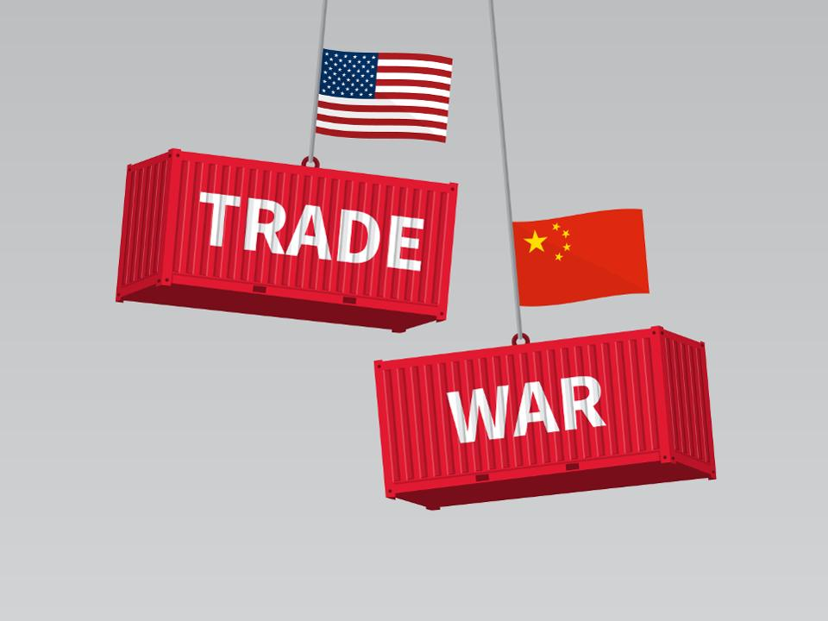
https://www.forbes.com/sites/michaelfoster/2019/11/09/a-surprising-way-to-play-the-trade-war-for-69-dividends/#3f306b254021
Trade War as a Game
Final Project 3547- Intelligent Agents and Reinforcement Learning
Shaoqing Tan
Shihan Sun

Slide 2

Background
Players
Options
Goals
De-Escalate
Leadership
US
US
Escalate
Econ-Growth
China
China
FX-Escalate
Global
Strategy
FED
Interest Rate
Treasury Bond Yield
Investor
Buy or Sell ?

Slide 3
Model 1 – Trade War
rng
Action
ε
argmax
State
Players:
US
China
Model
Q - Learning
State +1
Reward
US Q
CH Q

Slide 4
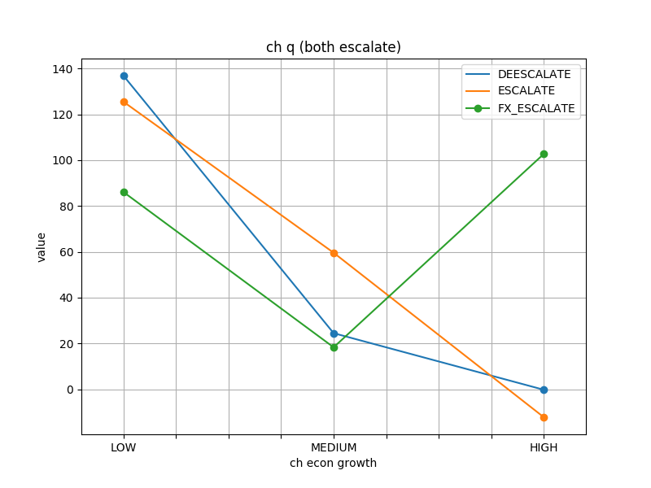
Model 1 – Trade War

Slide 5
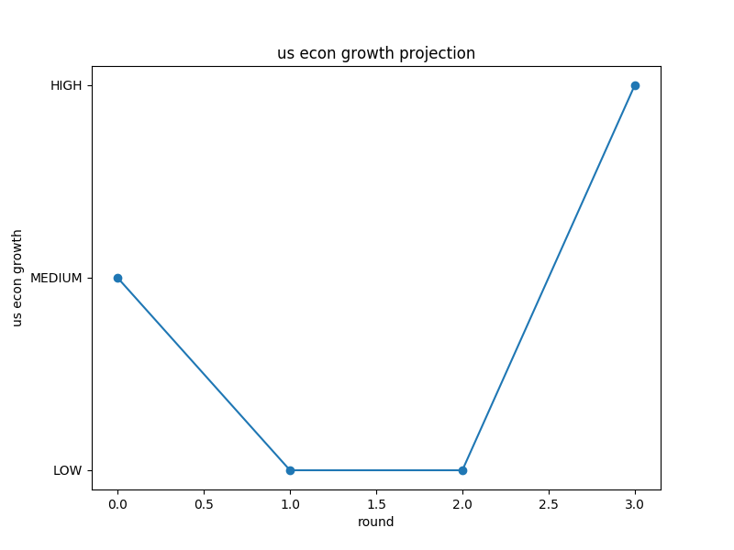
Model 1 – Trade War

Slide 6
Model 2 – Buy/Sell T-Bond
rng
Buy/Sell
ε
argmax
State
Episodes
Model
Q - Learning
State +1
Reward
Q

Slide 7
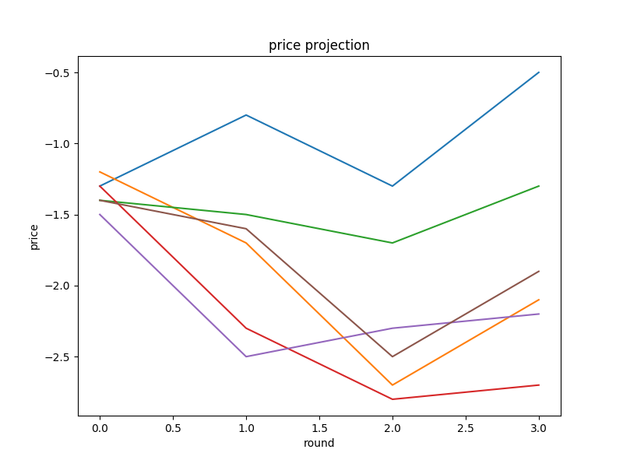
Model 2 – Buy/Sell T-Bond

Slide 8
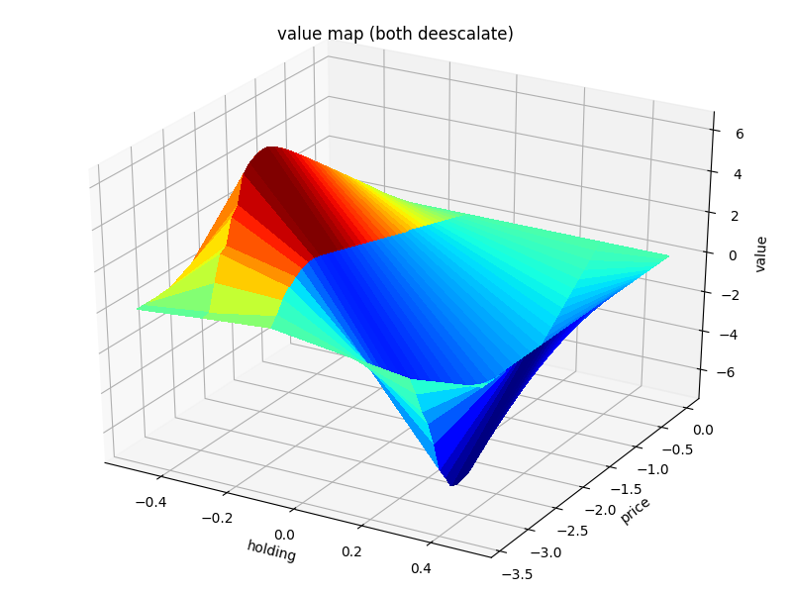
Model 2 – Buy/Sell T-Bond

Slide 9
Reference
https://github.com/ShangtongZhang/reinforcement-learning-an-introduction
https://www.forbes.com/sites/michaelfoster/2019/11/09/a-surprising-way-to-play-the-trade-war-for-69-dividends/#3f306b254021

Slide 10
Thank you !

